Slide 1




MS
PowerPoint
Class V
lab 20

Slide 2


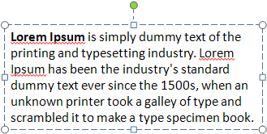
Adding A Text Box
Click Insert > Text > Text Box
to write something

Slide 3
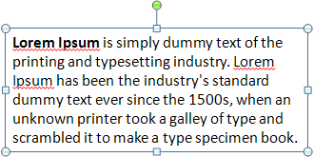

Moving A text box
select the text box as a whole then drag and drop to move

Slide 4

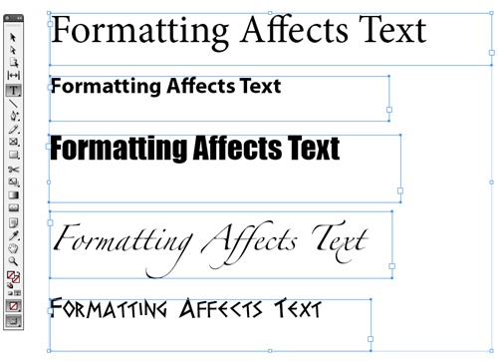
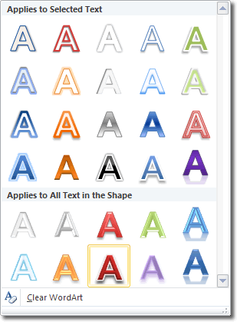

Format Text
To format some text, first of all select it. Change format as you desire

Slide 5


